Slide 1
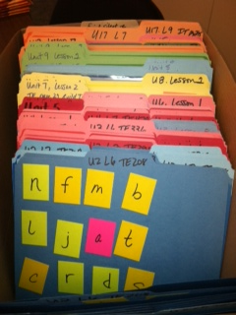
File Folder Activities

Slide 2
How do you use and store file folder games?
Label each folder with Unit number, Lesson Number and TE Page number.
Make 4-6 copies of each folder
Store folders in “paper” box in unit number order
Color code according to Books A-F. My colors are blown due to 3E and 4E.
Students work in groups of 2-3
Use for word building, reteaching,
Differentiation of instruction

Slide 3
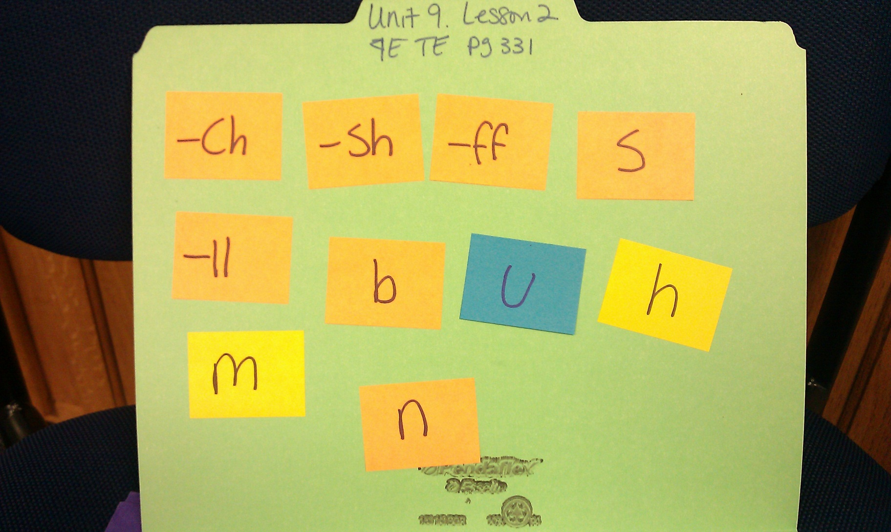
Creating words

Slide 4
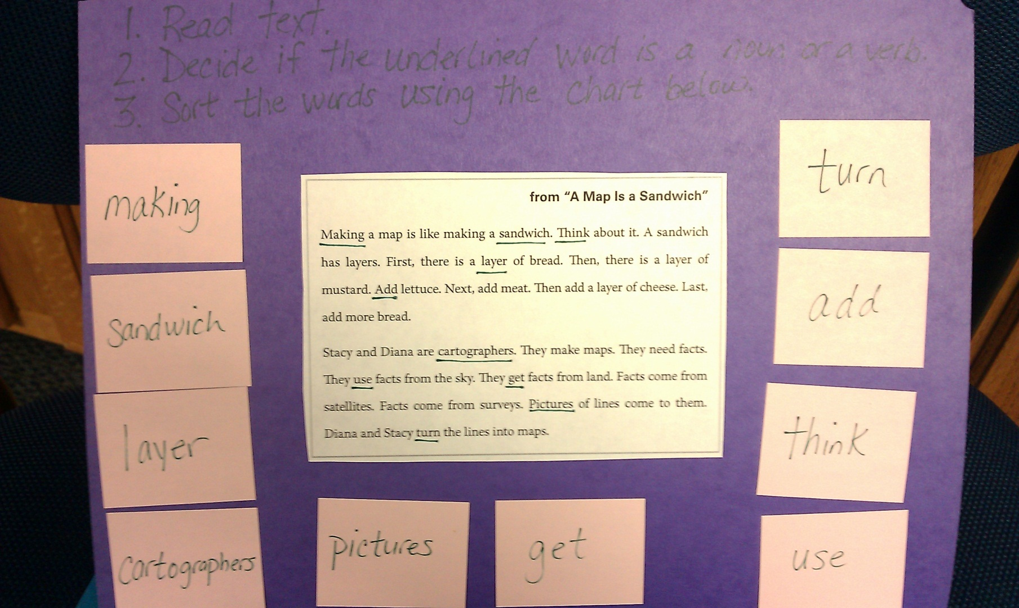
Noun/Verb Sort

Slide 5
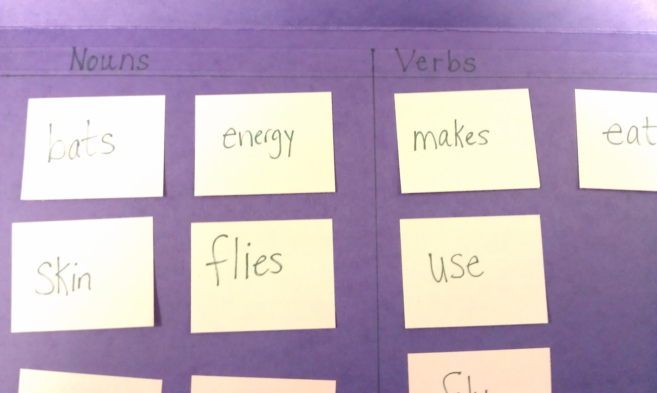
Noun/Verb Sort 2

Slide 6
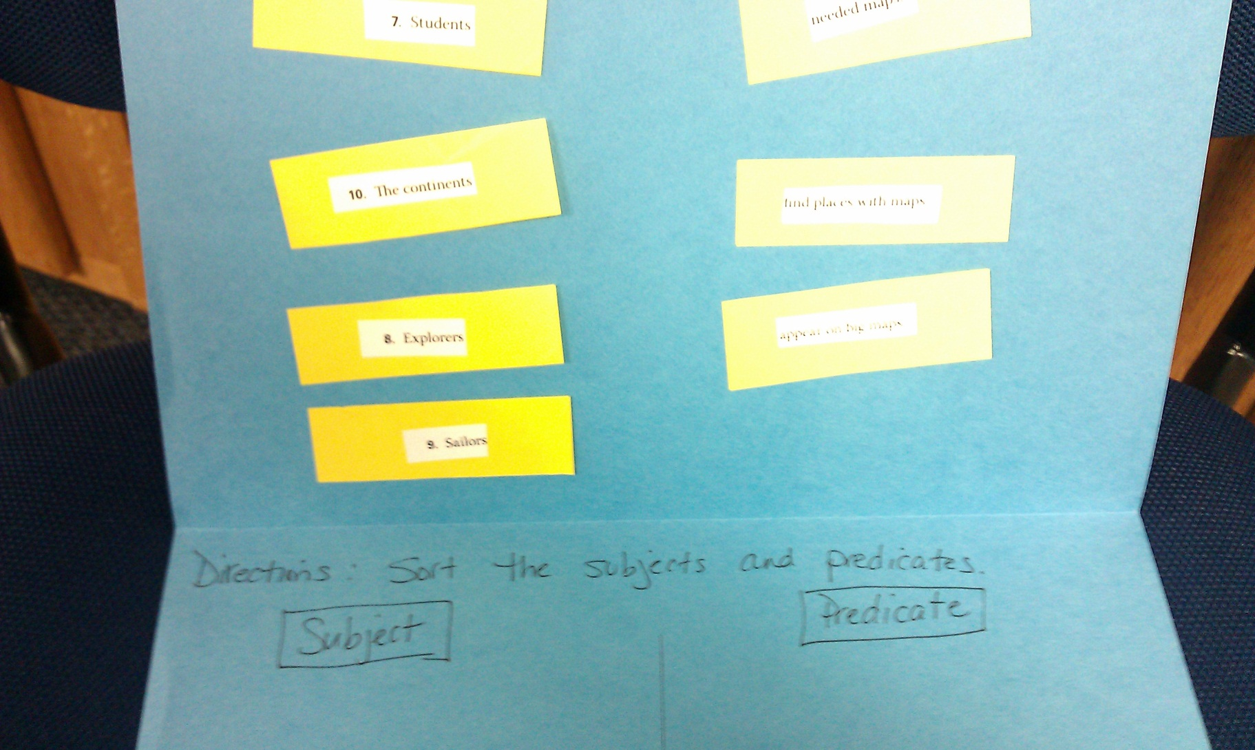
Subject/Predicate Sort

Slide 7
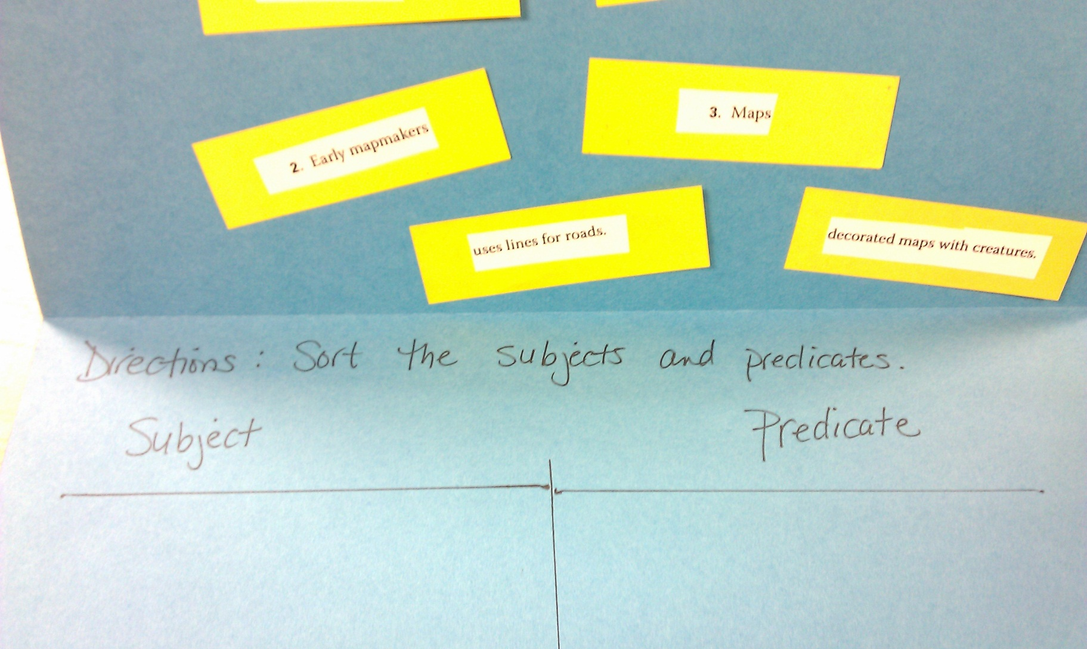
Subject/Predicate Sort 2

Slide 8
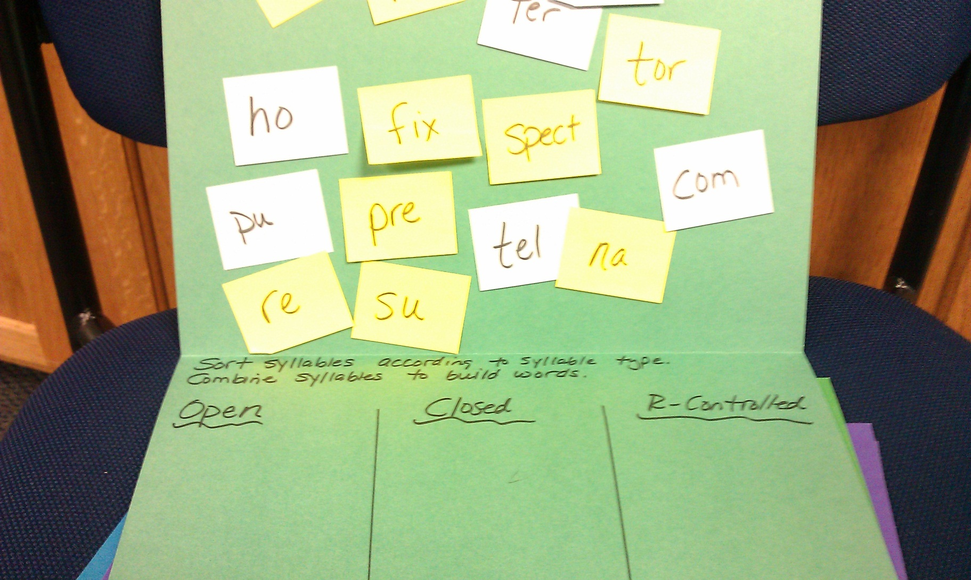
Syllable Sort

Slide 9
Credit where credit is due!
Thank you, Lauren from Lakeview Public Schools, for creating a powerpoint out of my file folders. I would not have thought of this idea!

